Slide 1


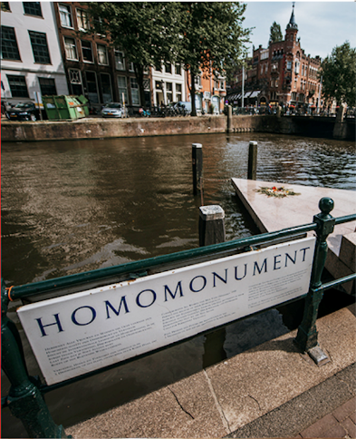

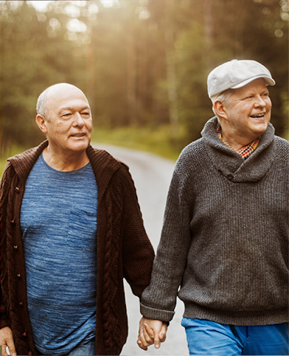
Union of Equality:
LGBTIQ Equality Strategy 2020-2025
TOWARDS LGBTIQ EQUALITY: FREE TO BE YOURSELF IN THE EU

Slide 2
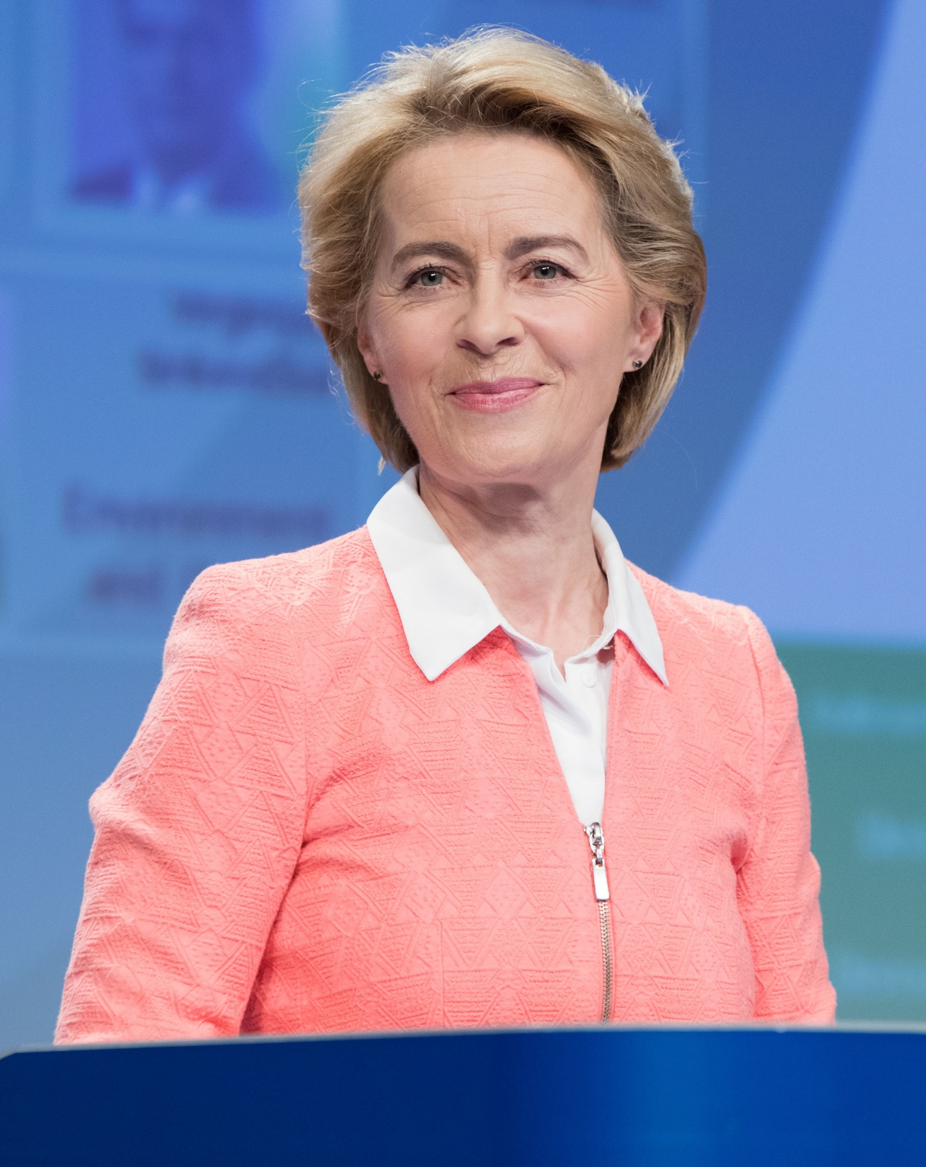

“I will not rest when it comes to building a Union of equality. A Union where you can be who you are and love who you want – without fear of recrimination or discrimination.
Because being yourself is not your ideology.
It’s your identity.
And no-one can ever take it away.”
Ursula von der Leyen
President of the European Commission
State of the Union 2020

Slide 3
Strong support to fight anti-LGBTIQ discrimination at EU level
2015-2019 List of actions by the European Commission to advance LGBTI equality
Calls by the Member States, the European Parliament and civil society for an LGBTIQ Strategy to be developed (outcome of the 2019 conference “Advancing LGBTI equality in the EU: from 2020 and beyond” organised by the Commission together with the Finnish Presidency)

Slide 4
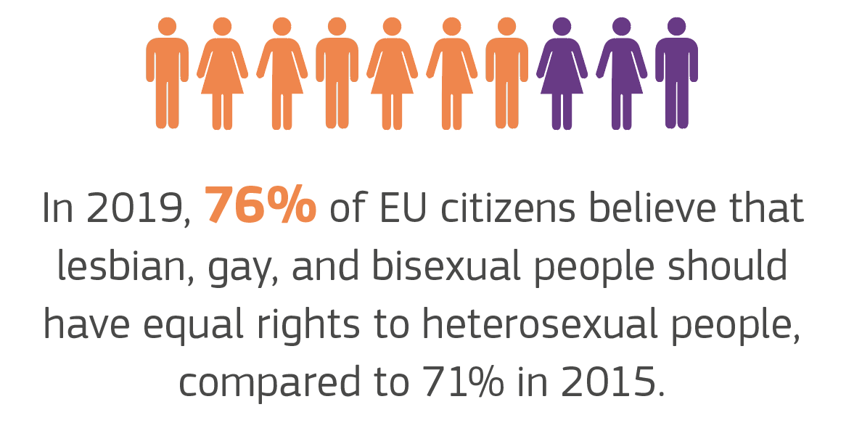
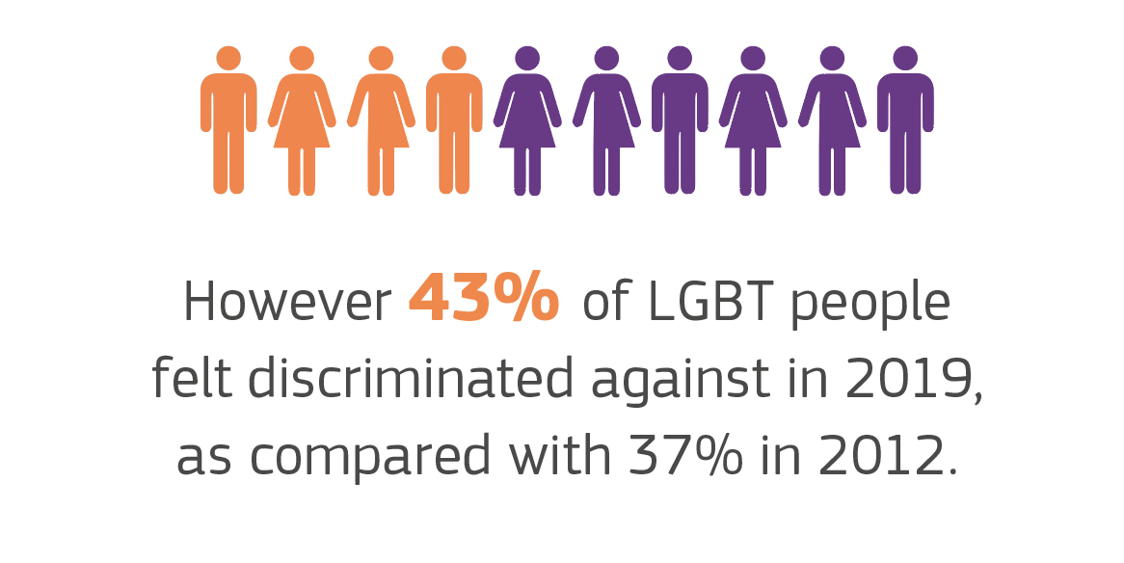
LGBTIQ equality is yet to be achieved

Slide 5



A vision for diversity
Have equal
opportunities
Be safe
Fully participate
in society

Slide 6




The first-ever LGBTIQ Equality Strategy
1.
Tackling discrimination against LGBTIQ people
2.
Ensuring LGBTIQ people’s safety
3.
Building LGBTIQ inclusive societies
4.
Leading the call for LGBTIQ equality around the world

Slide 7
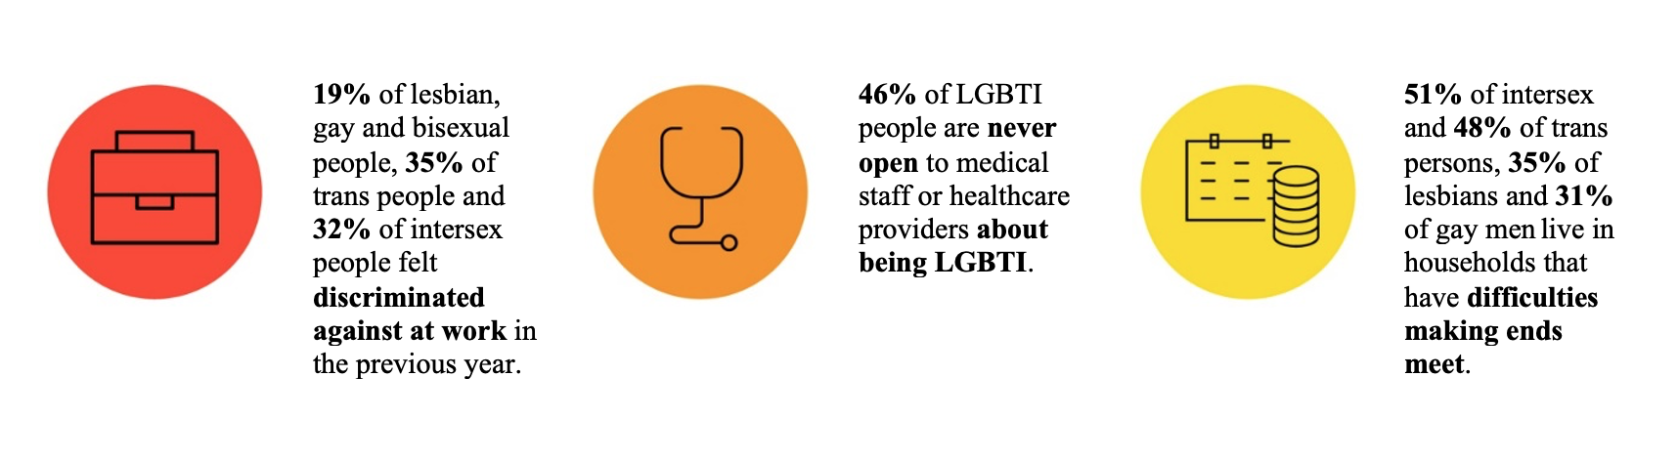
1. Tackling discrimination against
LGBTIQ people

Slide 8
1. Tackling discrimination against
LGBTIQ people: objectives
Enforcing and improving legal protection against discrimination
Promoting inclusion and diversity in the workplace
Combating inequality in education, health, culture and sport
Upholding the rights of LGBTIQ applicants for international protection

Slide 9
1. Tackling discrimination against
LGBTIQ people: key actions
European Commission
Member States
Propose by 2022 any legislation following up to the upcoming report on the implementation of the Employment Equality Directive, in particular to strengthen the role of equality bodies
Ensure appropriate protection of vulnerable (including LGBTIQ) applicants in the context of the common European asylum system and its reform
Ensure support for LGBTIQ equality in action under the Asylum and Migration Fund
Support health research of relevance to LGBTIQ people, including the trans and intersex communities, through Horizon Europe
Ensure legal protection against discrimination on the grounds of sexual orientation, gender identity/expression and sex characteristics in various areas
Improve safe and inclusive education for LGBTIQ children and youth
Address the specific needs of LGBTIQ applicants for international protection while ensuring safe reception, detention and accommodation conditions
Improve the training of protection officers and interpreters dealing with asylum claims by LGBTIQ people

Slide 10
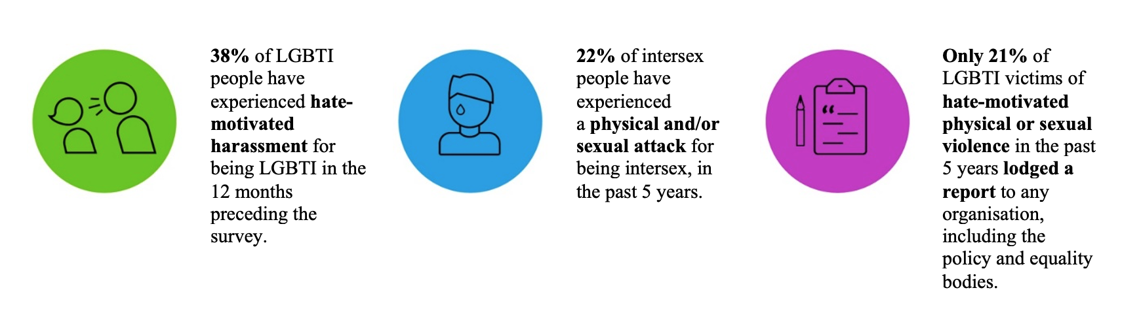
2. Ensuring LGBTIQ people’s safety

Slide 11
2. Ensuring LGBTIQ people’s safety: objectives
Reinforcing legal protection for LGBTIQ people against hate crime, hate speech and violence
Strengthening measures to combat anti-LGBTIQ online hate speech and disinformation
Reporting of anti-LGBTIQ hate crime and exchanges of good practices
Protecting and promoting LGBTIQ people’s bodily and mental health

Slide 12
2. Ensuring LGBTIQ people’s safety: key actions
European Commission
Member States
Present an initiative in 2021 to extend the list of ‘EU crimes’ (Article 83 TFEU) to cover hate crime and hate speech, including when targeted at LGBTIQ people
Provide funding opportunities for initiatives that aim to combat hate crime, hate speech, violence and harmful practices against LGBTIQ people (‘Citizens, Equality, Rights and Values’ programme) and promote the rights of victims of crime, including LGBTIQ people (‘Justice’ programme)
Table a Recommendation on the prevention of harmful practices against women and girls
Exchange best practice on protection against hate speech and hate crime against LGBTIQ people
Promote a safe and supportive environment for LGBTIQ victims of crime
Improve training and capacity building for law enforcement to better identify and record LGBTIQ-phobic bias and increase crime reporting

Slide 13
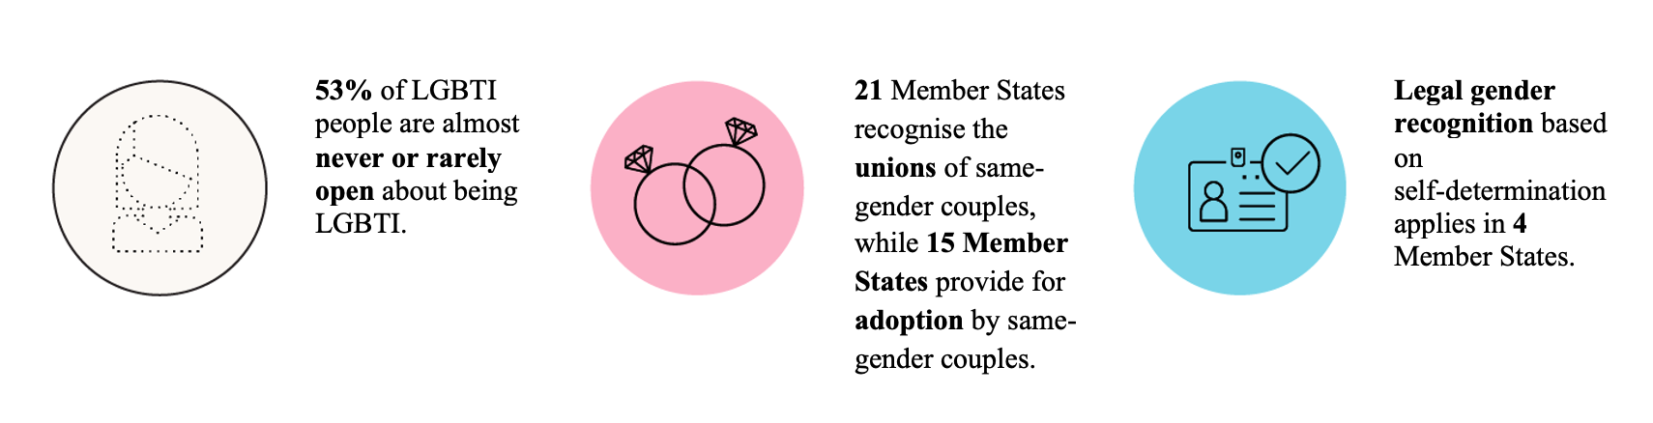
3. Building LGBTIQ inclusive societies

Slide 14
3. Building LGBTIQ inclusive societies: objectives
Ensuring rights for LGBTIQ people in cross border situations
Improving the legal protection of rainbow families in cross-border situations
Improving the recognition of trans and non-binary identities, and intersex people
Fostering an enabling environment for civil society

Slide 15
3. Building LGBTIQ inclusive societies: key actions
European Commission
Member States
Review the 2009 guidelines on free movement in 2022 to reflect the diversity of families and contribute to facilitating the exercise of free movement rights for all families, including rainbow families
Propose a horizontal legislative initiative on the mutual recognition of parenthood between Member States
Explore possible measures to support the mutual recognition of same-gender partnership between Member States
Make funding opportunities available, in particular through the ‘Citizens, Equality, Rights and Values’ programme
Put in place accessible legal gender recognition legislation and procedures
Improve the inclusion of trans, non-binary and intersex people in relevant documentation, applications, surveys and processes
Rigorously apply the right to free movement and EU rules on family law

Slide 16
4. Leading the call for LGBTIQ equality around the world: objectives
Strengthening the EU’s engagement on LGBTIQ issues in all its external relations

Slide 17
4. Leading the fight for LGBTIQ equality around the world: key actions
European Commission
Implement actions supporting LGBTIQ rights in line with the 2020-2024 Action Plan on human rights and democracy and with the EU Guidelines to promote and protect the enjoyment of all human rights by LGBTI persons
Ensure support for LGBTIQ equality in action under the NDICI and IPA funds

Slide 18
5. Delivering on the strategy
TARGETED ACTIONS
MAINSTREAMING
INTERSECTIONALITY
EQUALITY DATA
LGBTIQ SUBGROUP
STAKEHOLDER ENGAGEMENT
NATIONAL ACTION PLANS
MONITORING

Slide 19
A joint effort is needed to achieve
LGBTIQ equality

Slide 20
Keep in touch
LGBTIQ Equality Strategy 2020-2025: https://ec.europa.eu/info/files/lgbtiq-equality-strategy-2020-2025_en
Contact us via e-mail: JUST-LGBTI@ec.europa.eu

Slide 21
Thank you
© European Union 2021
Unless otherwise noted the reuse of this presentation is authorised under the CC BY 4.0 license. For any use or reproduction of elements that are not owned by the EU, permission may need to be sought directly from the respective right holders.

